Slide 1
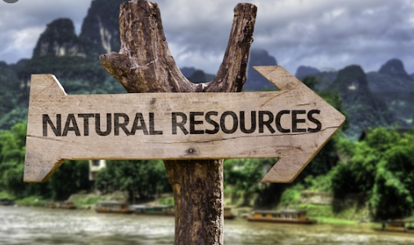

Slide 2
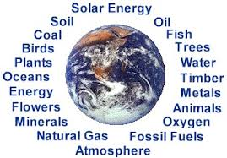
Definition
Natural Resource is defined as a form of energy and/or matter which is essential for the functioning of organisms, population and ecosystem.

Slide 3
Classification :
Natural Resource
Biotic
e.g. forest, fish, wildlife etc.
Abiotic
e.g. petrol, oil, gas, minerals etc.
Flow
e.g. wind, water, tides etc.

Slide 4
1. Tropical forests 2. Deciduous and coniferous forests 3. Grasslands /Savannas 4. Desert 5. Tundra forests
Classified based on temperature and rainfall:

Slide 5
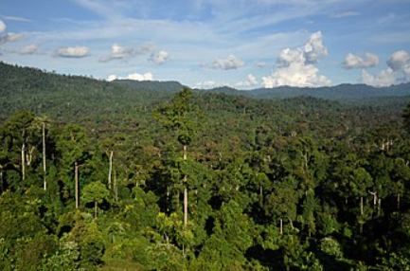
Tropical forests
Tropical rainforests are rainforests that occur in areas of tropical rainforest climate in which there is no dry season – all months have an average precipitation of at least 60 mm – and may also be referred to as lowland equatorial evergreen rainforest.
Source: wikimedia

Slide 6
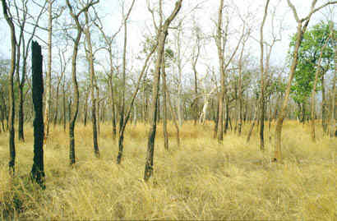
Deciduous forests
The word "Deciduous" means "falling off or out at a certain season".
That explains why deciduous forest means a forest in which the leaves fall off the trees when the winter comes.
The deciduous forests are located in the temperate zone above the tropical forests and below the coniferous forests.
Source: wikimedia

Slide 7
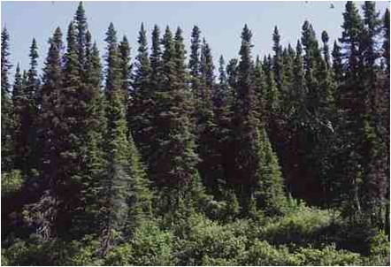
Coniferous forest
Coniferous forests are made up mainly of cone-bearing or coniferous trees, such as spruces, hemlocks, pines and firs.
The leaves of these trees are either small and needle-like or scale-like and most stay green all year around (evergreen).
All are softwoods able to survive cold temperatures and acidic soil.
Source: wikimedia

Slide 8
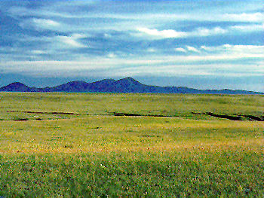
Grassland
A grassland is a region where the average annual precipitation is great enough to support grasses, and in some areas a few trees.
The precipitation is so erratic(not even or regular in pattern) that drought and fire prevent large forests from growing.
Grasses can survive fires because they grow from the bottom instead of the top.
Source: wikimedia

Slide 9
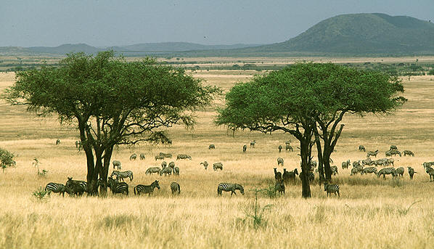
Savannas
A savanna is a rolling grassland scattered with shrubs and isolated trees, which can be found between a tropical rainforest and desert biome.
Not enough rain falls on a savanna to support forests.
Savannas are also known as tropical grasslands.
Difference between Grassland and Savanna:
Grassland has no trees, whereas Savanna has scattered trees
Source: wikimedia

Slide 10
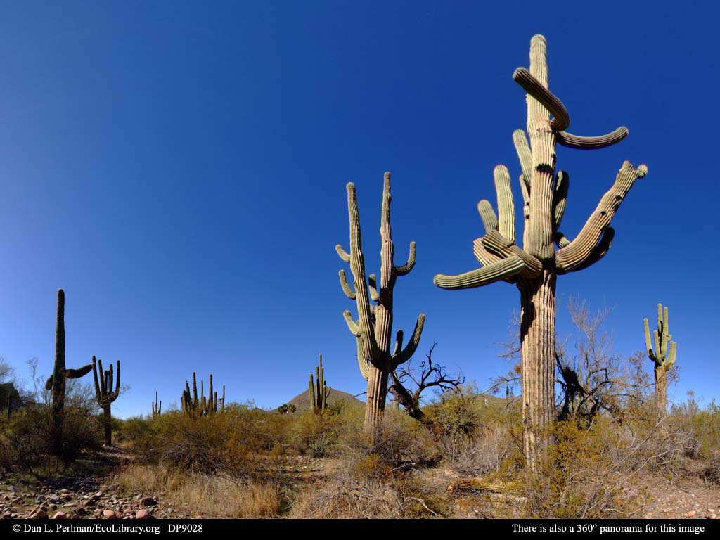
Desert
A desert is a barren area of landscape where little precipitation occurs and, consequently, living conditions are hostile for plant and animal life. The lack of vegetation exposes the unprotected surface of the ground to the processes of denudation.
Source: wikimedia

Slide 11
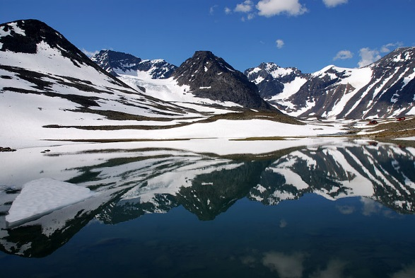
Tundra
Tundra is the coldest of all the biomes. Tundra comes from the Finnish word tunturia, meaning treeless plain. It is noted for its frost-molded landscapes, extremely low temperatures, little precipitation, poor nutrients, and short growing seasons.
Dead organic material functions as a nutrient pool. The two major nutrients are nitrogen and phosphorus. Nitrogen is created by biological fixation, and phosphorus is created by precipitation.
Source: wikimedia

Slide 12
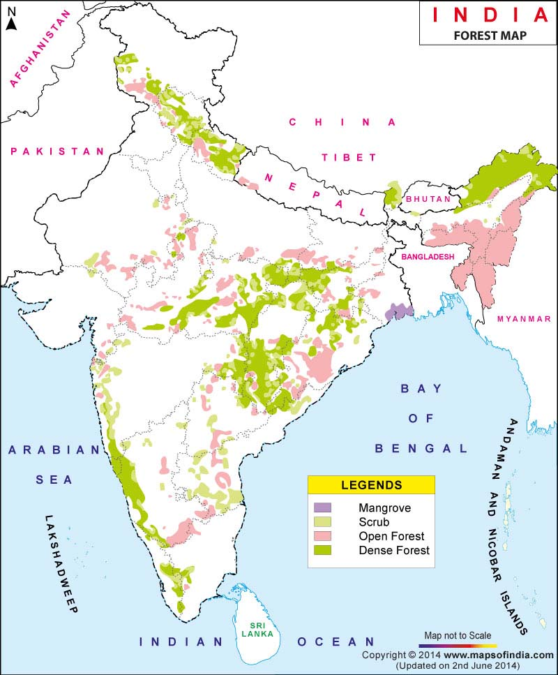
Source: http://www.fsi.org.in/cover_2013/sfr_forest_cover.pdf

Slide 13
Forests in India…
As per 2013 survey, present forest cover is 6,97,898 sq.km(21.23%).
2.54% very dense forests (tree canopy density-TCD >70%),
9.7% moderately dense forests (TCD <70% >40%) and
9% open forests (TCD<40% >10%)
Largest forest cover is in Madhya Pradesh (77,522 sq.km)
Followed by Arunachal Pradesh (67,321 sq.km.) & Chattisgarh (55,621 sq.km)

Slide 14
Why are they important?
Play a very crucial role in every nation’s economical, social and cultural activities .
Many river systems originate in forests and anchor rich biodiversity.
Forests provide
timber
industrial wood
fuel wood
pulp for paper and
many non-timber products to the local communities and national economy.

Slide 15
Why are they important…
Valuable source of biodiversity & provide important ‘Gene-Pool’ from which we derive medicines, domesticated plants, animals etc.
Reduce the energy of rainfall (sponge action) and reduce soil erosion.
Also reduce floods; moderate climate and serve as sink for carbon dioxide.
Shelter for large number of animals species.

Slide 16
Impact of Forests
In India more than 2,00,000 villages are located in the fringe of forests.
More than 20 crore people (including 7 crore tribals) depend on forests for their livelihood.
About 3 crore people are directly involved in gathering & trading non-timber forest products like fruits, seeds, flowers, leaves, honey, lac, gum etc.
Any impact on forest vegetation & biodiversity will have adverse implications for livelihood of forest-dependent communities.

Slide 17
Causes of deforestation
Increase in population
Urbanization & industrialization
Mineral exploration
Construction of dam reservoirs
Infrastructure development
Over grazing & Forest fires
Human encroachment & exploitation
Pollution-acid rain

Slide 18
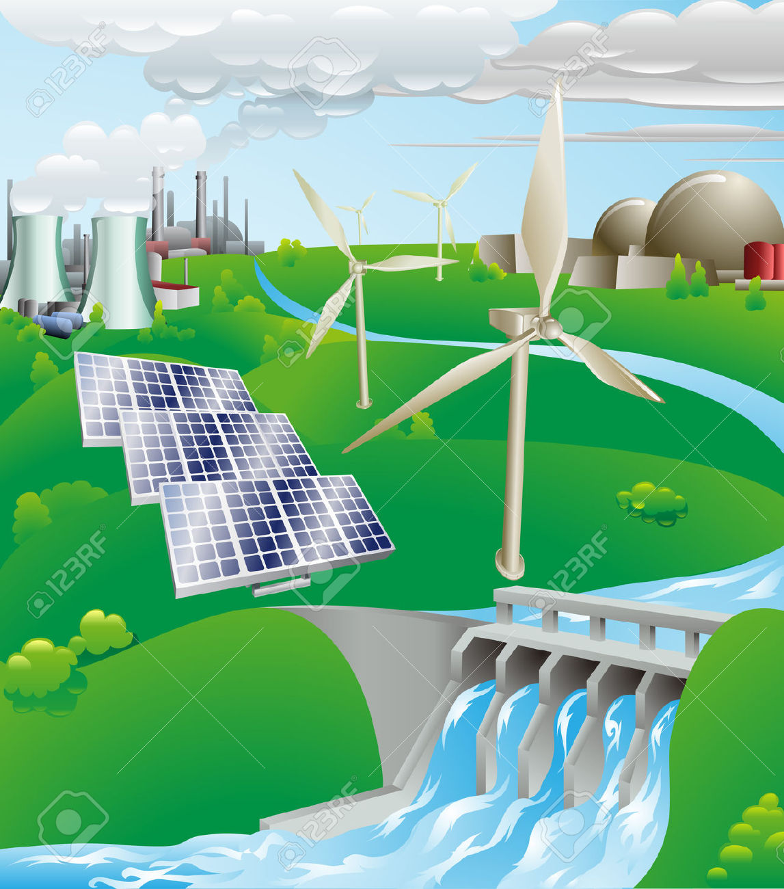
Energy Resources

Slide 19
Classification
Types
Renewable
Non renewable
Sustainable

Slide 20
Types of energy sources
Renewable
Wind
Wave
Solar
Hydro-power
Fuel-cells
Biofuels: biomass, biodiesel, methane from organic waste,
OTEC (ocean thermal exchange capacitors)
Non-renewable
Fossil fuels— petroleum, coal, gas
Sustainable
Nuclear power

Slide 21
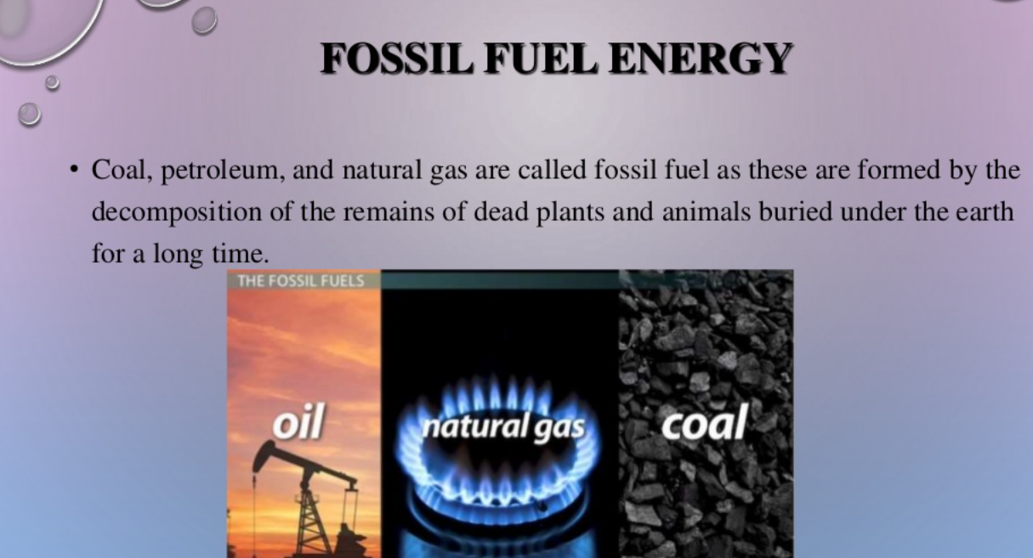

Slide 22
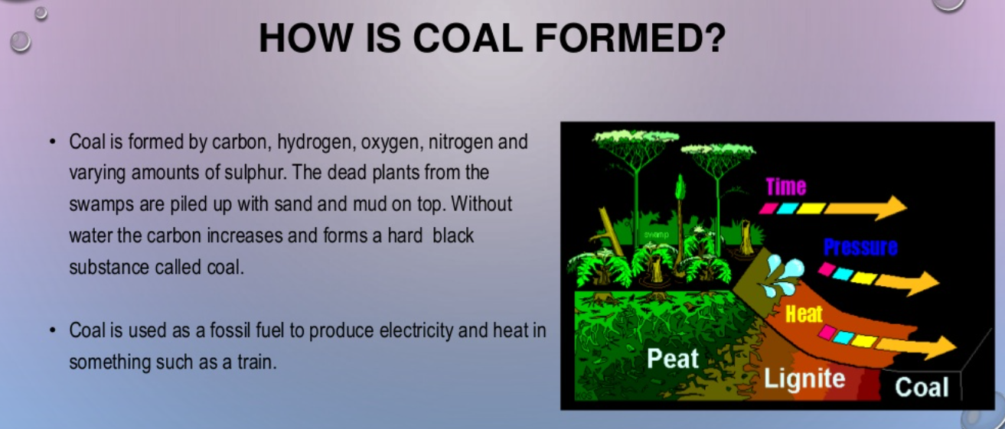

Slide 23
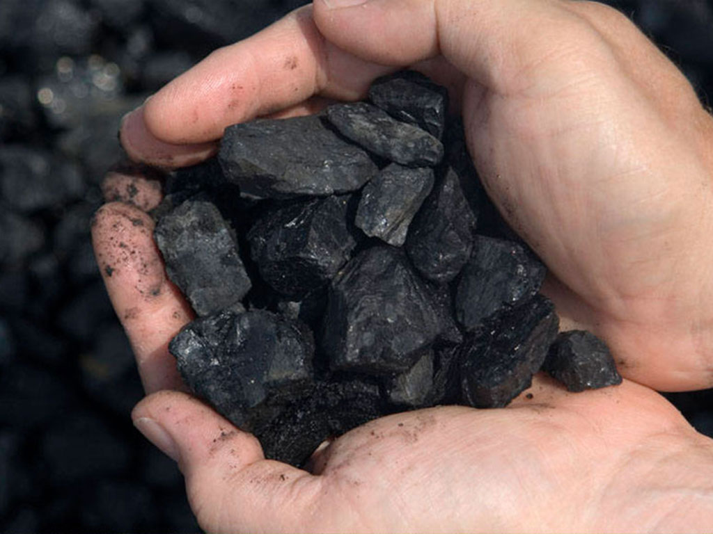
Non –renewable : Coal
Was the first fossil fuel to be used on an industrial scale.
Remains a major force in world energy.
Economically recoverable reserves exist in about 70 countries.
At the current rate of production, global coal reserves are estimated to last for almost another 150 years.

Slide 24
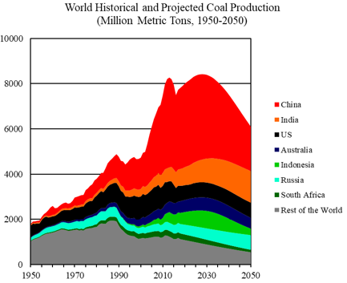
Data Sources : World Coal 2018-2050, World Energy Annual Report (Part 4)

Slide 25
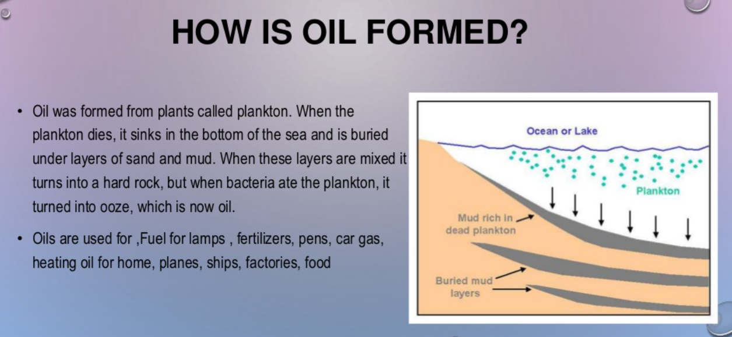

Slide 26
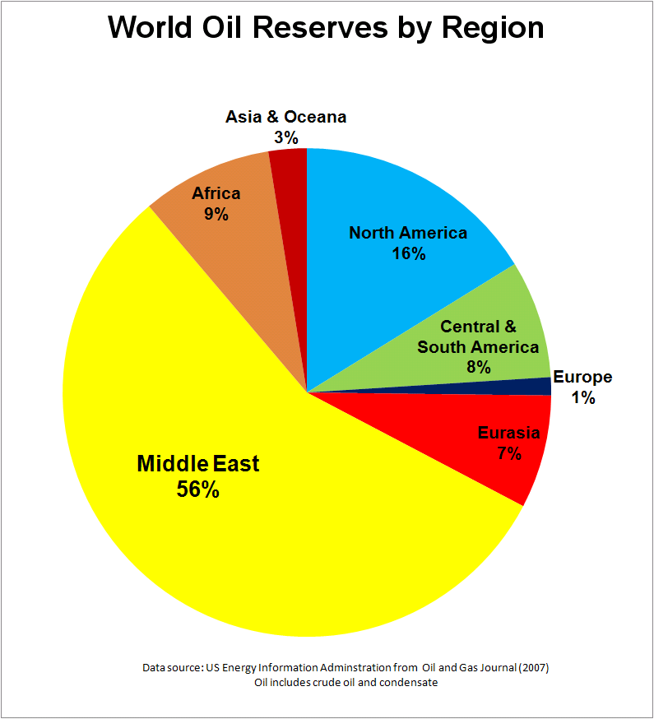

Slide 27
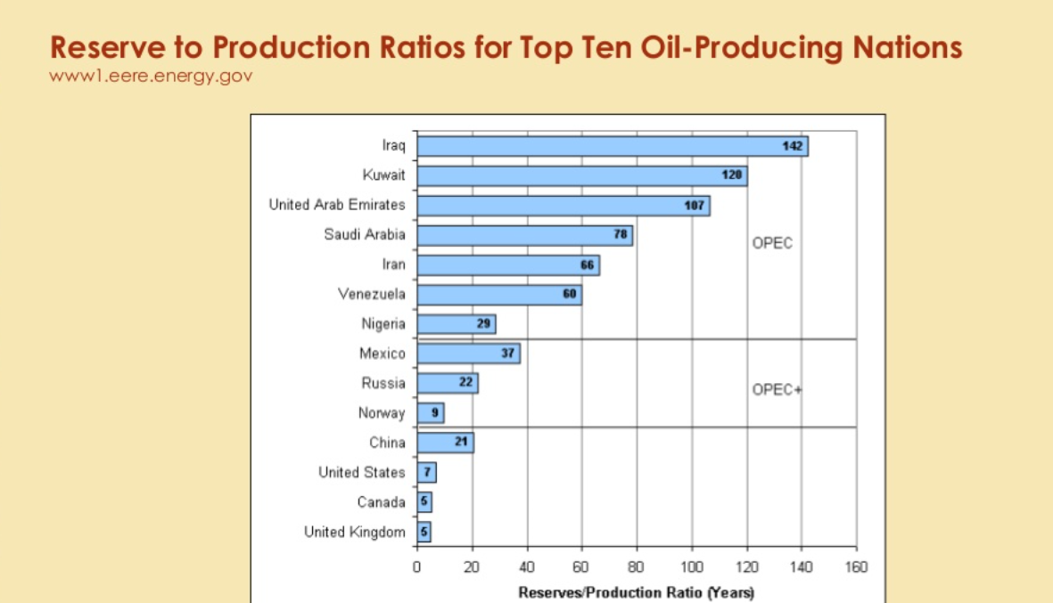

Slide 28
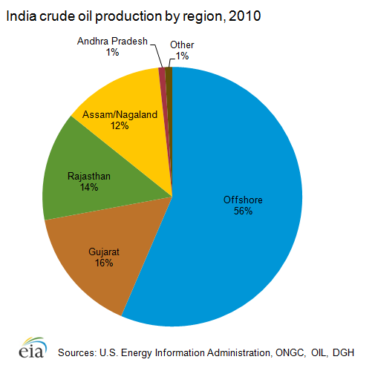

Slide 29
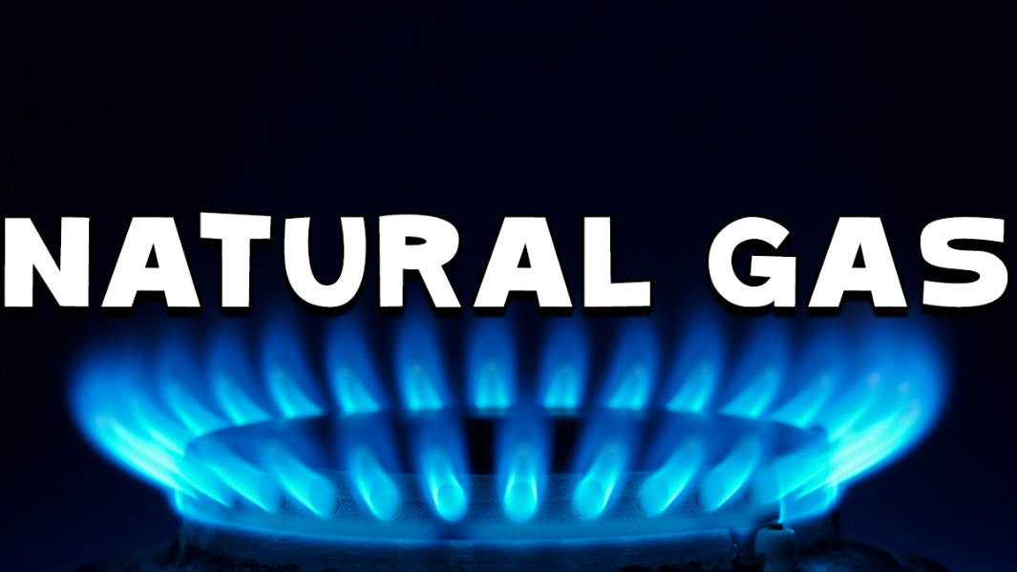
Natural Gas
Composition of natural gas- 95% methane and other hydrocarbons
Since 1980, the world’s proved reserves of natural gas have increased at an average annual rate of 3.4% (compared with 2.4% for oil).
It currently accounts for 23.5% of the world energy mix and ranks third, behind oil and coal.
This expansion was sparked by many essential breakthroughs.
Natural gas liquefaction
long distance pipelines
deep offshore pipe-laying
gas-fired power plants
A more environment-friendly energy.

Slide 30
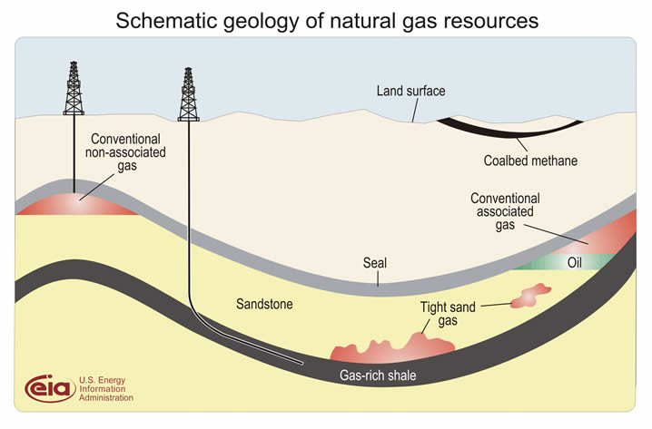
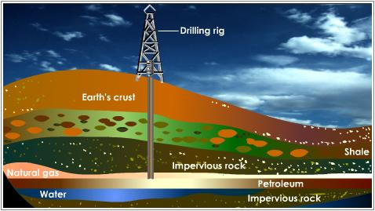
Occurrence of natural gas

Slide 31
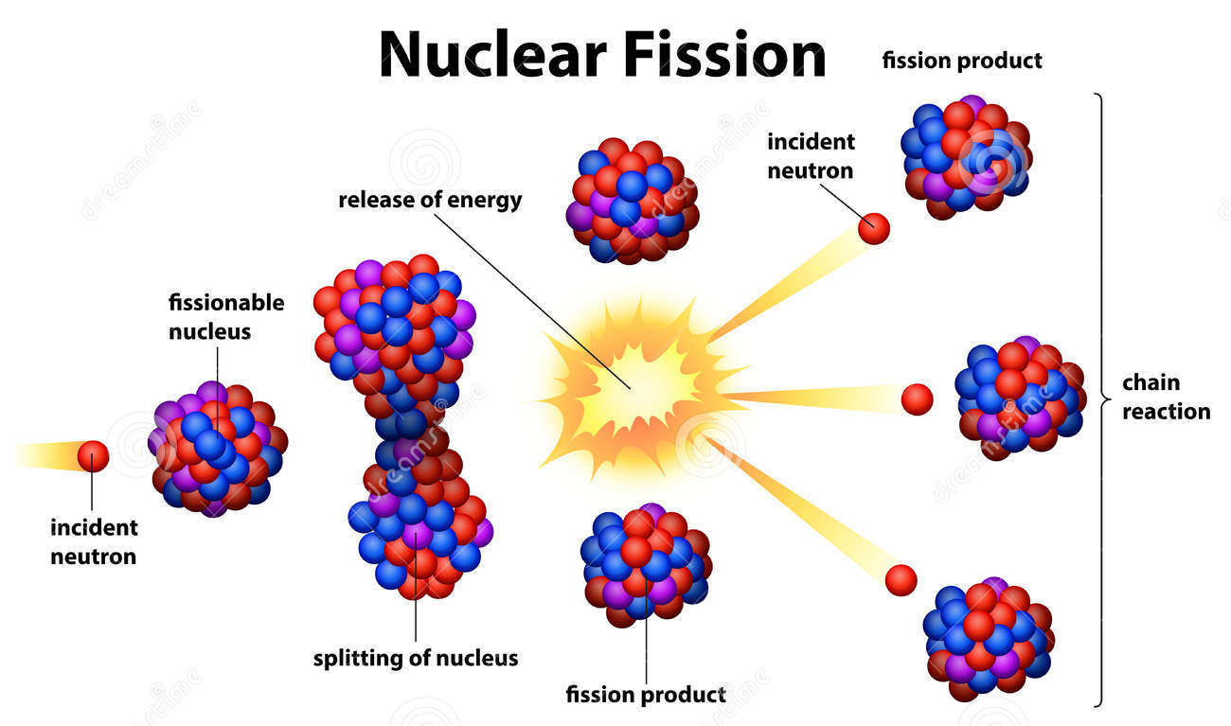
Nuclear Energy…
Nuclear energy is renewable and economic alternative for coal.
Alternative to fossil fuels
Both fission and fusion are nuclear reactions that produce energy, but the applications are not the same. Fission is the splitting of a heavy, unstable nucleus into two lighter nuclei, and fusion is the process where two light nuclei combine together releasing vast amounts of energy
Notes:
Due to bad

Slide 32
Nuclear power is the use of nuclear reactions that release nuclear energy to generate heat, which most frequently is then used in steam turbines to produce electricity in a nuclear power plant. Nuclear power can be obtained from nuclear fission, nuclear decay and nuclear fusion

Slide 33
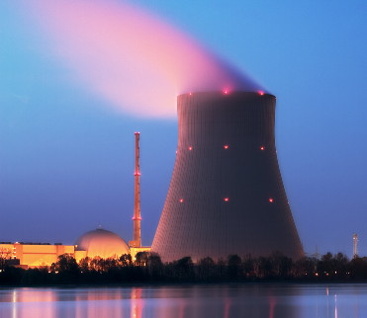
Nuclear reactor
Source: wikimedia

Slide 34
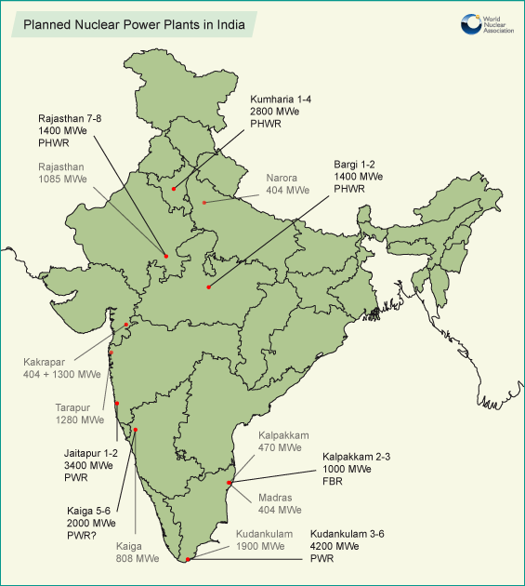
Source : World nuclear association

Slide 35
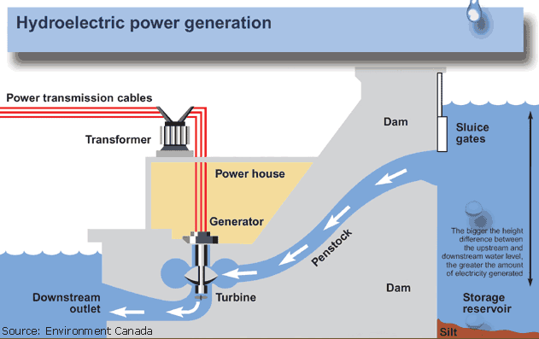
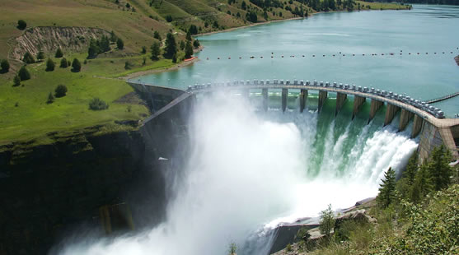
Hydropower…
Hydro helps power generation in 160 countries.
Five countries make up more than half of the world’s hydropower production: Brazil, Canada, China, Russia and the USA.
Source: wikimedia

Slide 36
The Changing Role of Hydropower
There are 45,000 large dams in the world and the majority do not have a hydro component. Need to use it for power generation
Long-term economic advantage. Operating costs minimal-autonomy from the fuel price is a distinct advantage.
Water management- multipurpose hydro reservoirs can bring security of water supply as well as power.

Slide 37
Disadvantages
Water logging
Salinity of lands
Siltation of reservoirs
Submergence of forest lands and villages
Displacement and rehabilitation of people affected
Possibility of earthquakes

Slide 38
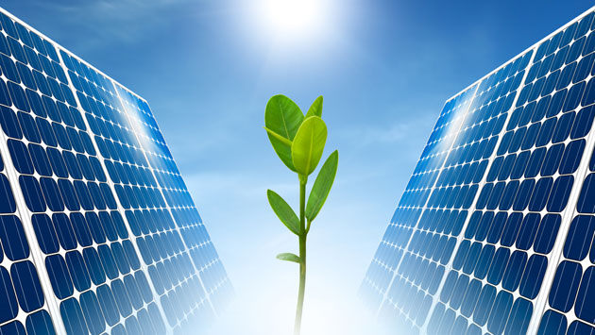
Solar energy
The Sun is the most abundant permanent source of energy for its planet Earth.
Solar energy is available both
directly as solar radiation and
indirectly in the form of power from wind, biomass, hydro, and marine sources.
Source: wikimedia

Slide 39
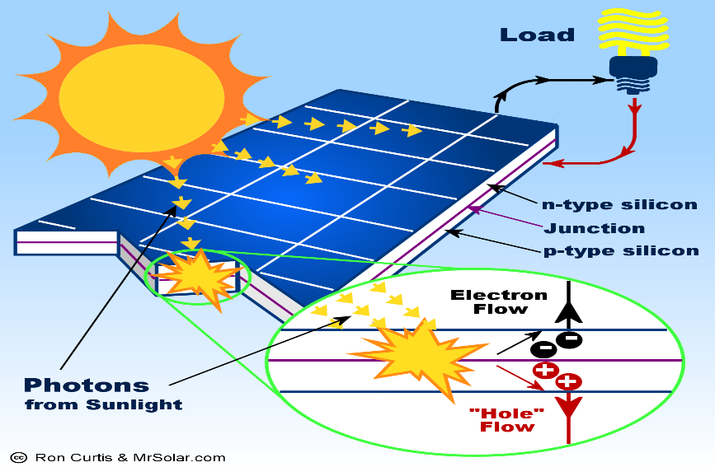
Devices
There are two basic types of device currently used to capture and utilize solar radiation:
Solar thermal collectors, which are used to heat air,
water or other liquids, depending on the application
Photovoltaic (PV) collectors, which convert
sunlight directly into electricity.

Slide 40
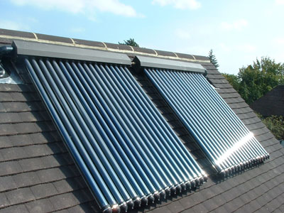
Solar thermal collector
Source: wikimedia

Slide 41
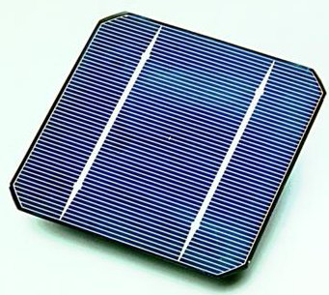
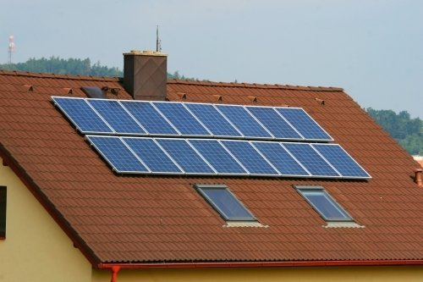
PV cell- roof top solar panels
Source: wikimedia

Slide 42
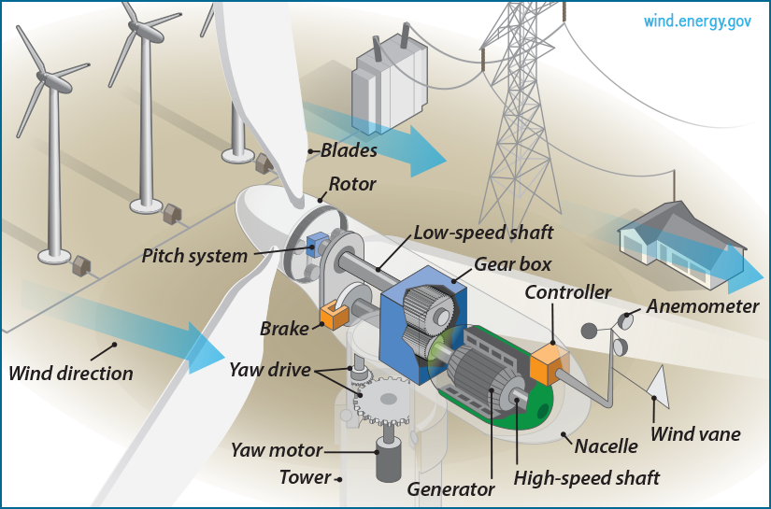
LECTURE - 04 Wind Energy

Slide 43
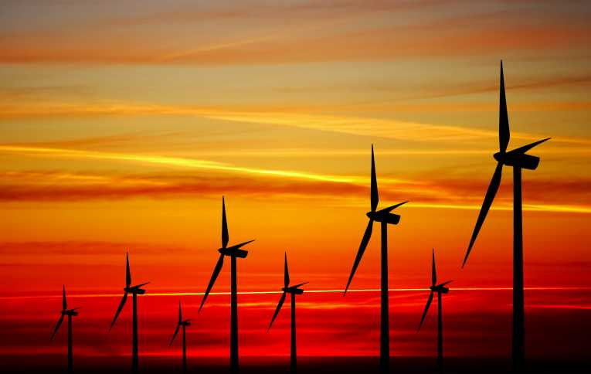
So how do wind turbines make electricity?
Simply stated, a wind turbine works the opposite of a fan.
Instead of using electricity to produce wind, like a fan, wind turbines use wind to produce electricity.
The wind turns the blades, which spin a shaft, which connects to a generator and produces electricity.
Source: wikimedia

Slide 44
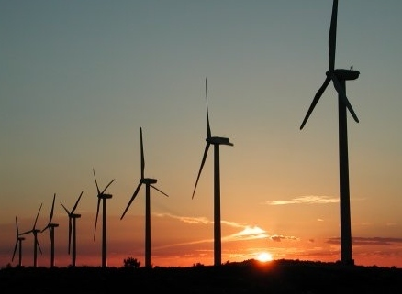
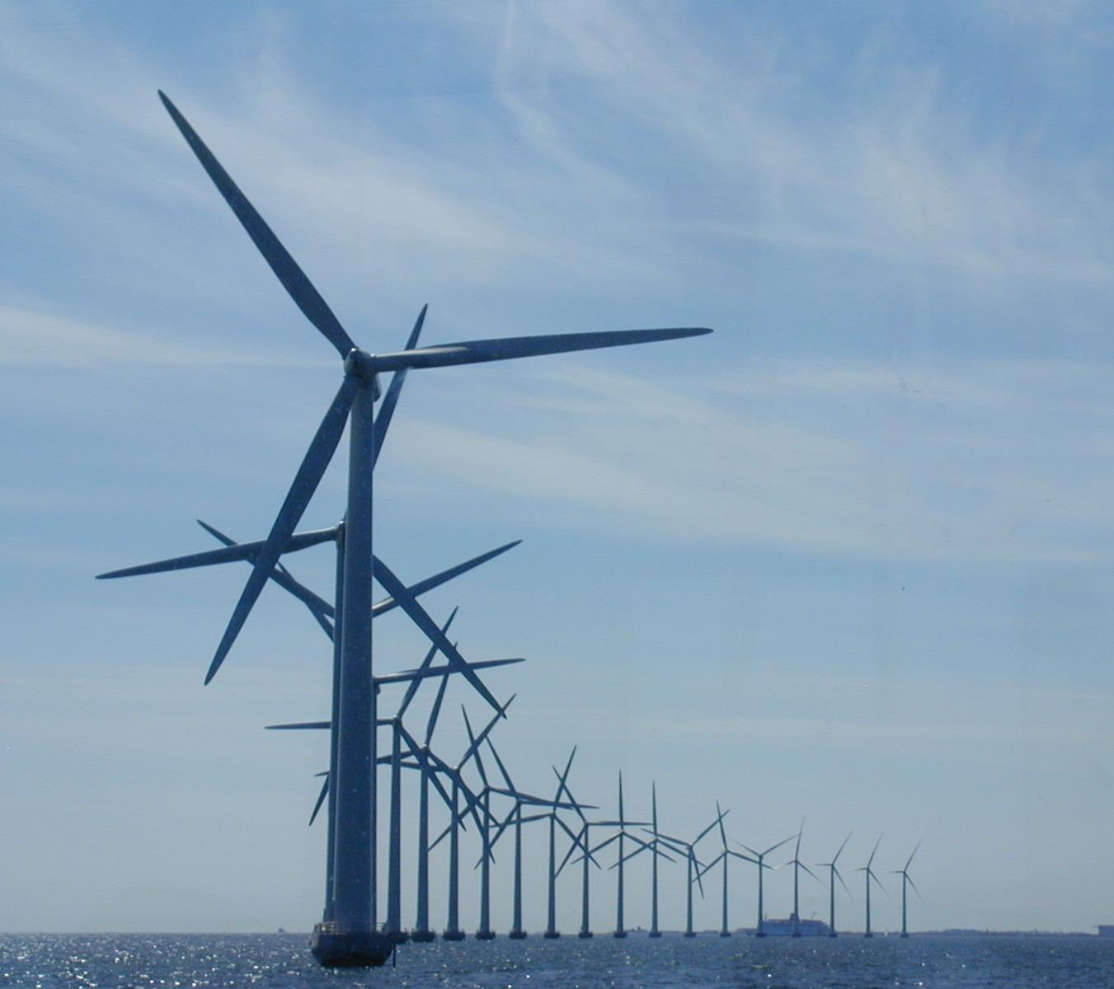
Wind Energy
Source: wikimedia

Slide 45
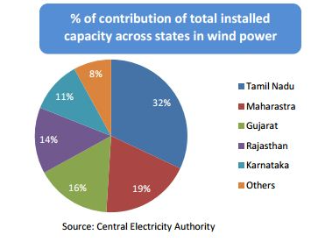
State-wise electricity produced from wind

Slide 46
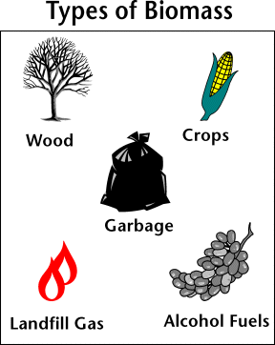
Biomass energy
Biomass is biological material derived from living, or recently living organisms.
In the context of biomass for energy this is often used to mean plant based material, but biomass can equally apply to both animal and vegetable derived material.

Slide 47
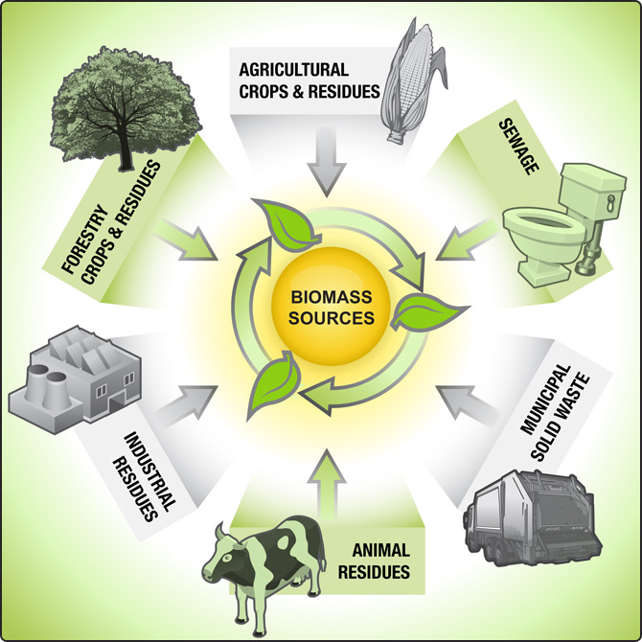
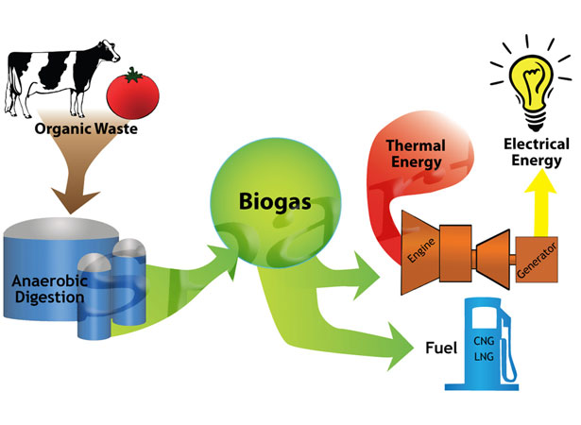

Slide 48
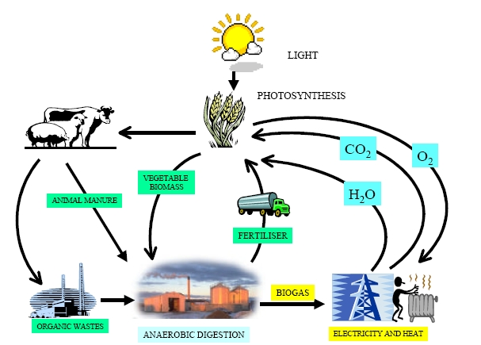
Biomass to Biogas (65%methane, 30% carbon dioxide)

Slide 49
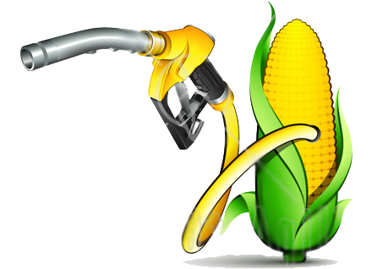
Biogas…
Microbial activity releases methane by decomposing organic matter under ANAEROBIC conditions.
Estimated power of about 19.5 GW can be generated from wood, crop residue, forest sources
Bio-gas plants in small scale are adopted in small sector- households using agricultural residues and animal waste.
This gas can be used for cooking and domestic lighting purposes.

Slide 50
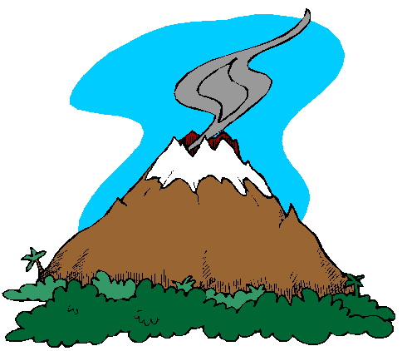
Geothermal energy…
Geothermal energy is, in the broadest sense, the natural heat of the Earth.
This heat can be exploited as a source of energy
utilize (via heat pumps) the temperature difference between the ambient temperature and that of the ground.

Slide 51
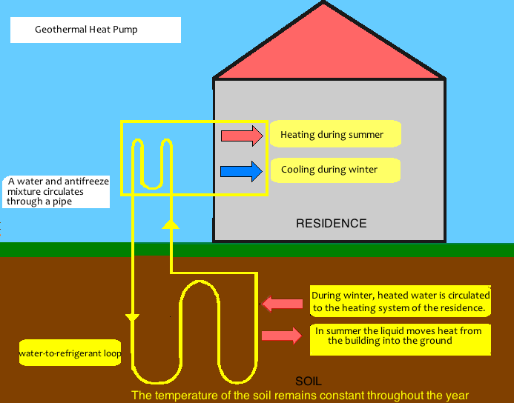
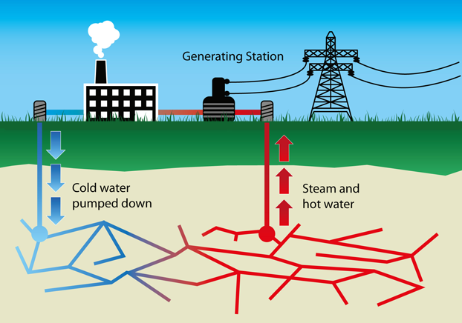
Source: wikimedia

Slide 52
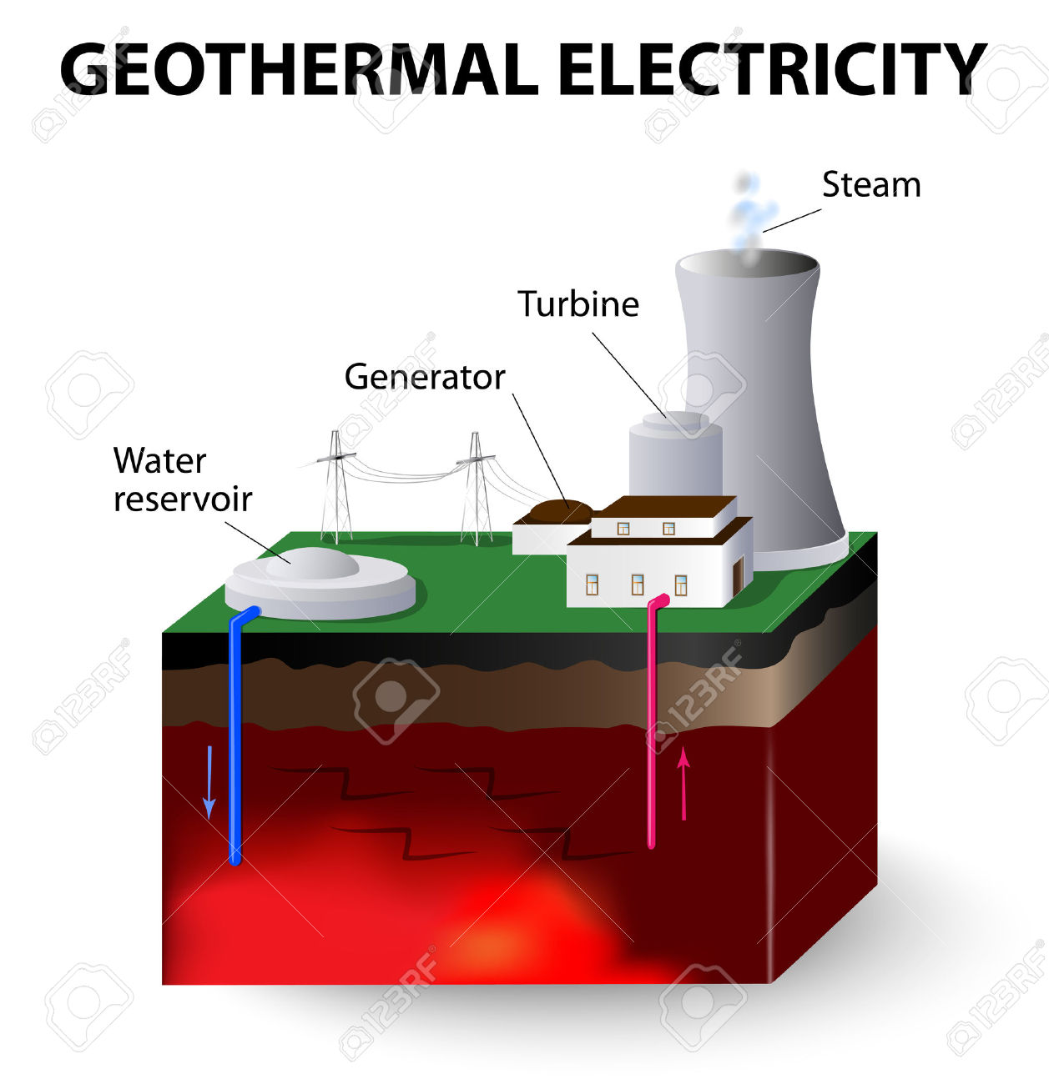
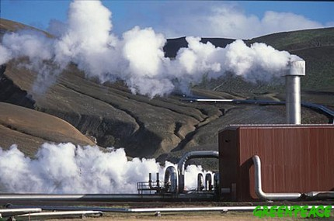
Geothermal plant
Source: wikimedia

Slide 53
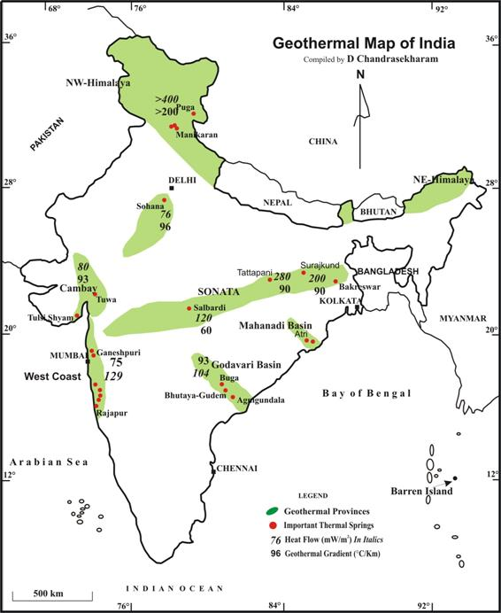
Source: http://www.geosyndicate.com/dchandra/geoenergyresource.html

Slide 54
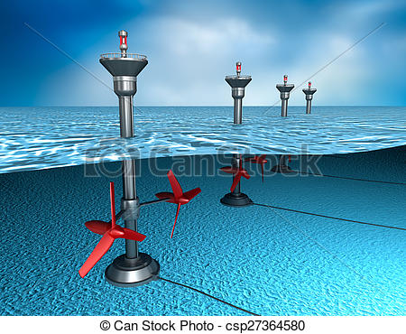
Tidal energy
The tides – cyclic variations in the level of the seas and oceans – give rise to water currents which constitute a potential source of power.
an estuary or bay with a large tidal range is being enclosed by a barrier. Electricity is generated by allowing water to flow from one side of the barrier to the other, through low-head turbines.

Slide 55
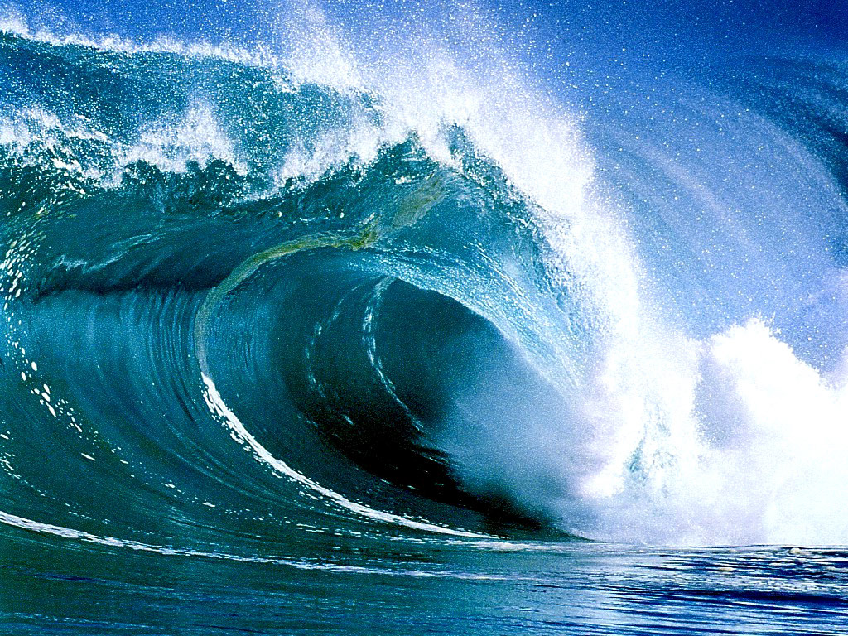

Turning Tides into Usable Energy
A dam (barrage) is built across the mouth of an estuary.
Sluice gates allow incoming tides to fill the basin.
As the tide ebbs(receding tide),
the water is forced through a turbine system to generate electricity.
Source: wikimedia

Slide 56

Ocean Thermal Energy Conversion (OTEC)
Is a means of converting into useful energy the temperature difference between the surface water in tropical and sub-tropical seas and cold water at a depth of about 1,000 metres, which emanates from the polar regions.
A temperature difference of 20ºC is adequate for OTEC: this level is encountered over wide ocean areas, particularly near islands and off the coast of certain developing countries.
Unlike most renewable energy technologies, OTEC has the advantage of providing base-load power, available at a constant rate throughout the 24 hours, and varying very little with the seasons.
Source: wikimedia

Slide 57
Three basic ways to tap ocean for its energy
Waves : Kinetic energy of the moving waves in the ocean can be used to power a turbine.
Tidal energy (Renewable resource) : A difference of atleast 5m height between high and low tides is required for generating power.
Temperature difference in water.

Slide 58

Source: wikimedia

Slide 59


Slide 60

Source: wikimedia

Slide 61

Source: wikimedia

Slide 62

Source: wikimedia

Slide 63
Water Resources
Any disturbance to the flow of the rivers causes drought or floods.
Floods are the result of peculiar rainfall pattern. Of the total annual rainfall, 75% occurs over 3-4 months. This leads to very heavy discharge from rivers which floods large areas.
Drought occur when rainfall is less than 400mm /year
Ganga-Brahmaputra-Meghna, which carry about 60% of total river flow is the most flood prone region of India. States of Assam, Bihar, Uttar Pradesh (about 19 million hectares of land) get affected almost every year by floods.
Similarly 16% of the land area spread over 16 states is drought prone in India.

Slide 64

Watershed management

Slide 65
What is Rain Water Harvesting?
Rainwater harvesting is the process of augmenting the natural filtration of rainwater in to the underground formation by some artificial methods.
"Conscious collection and storage of rainwater to cater to demands of water, for drinking, domestic purpose & irrigation is termed as Rainwater Harvesting”.
Why Rain Water Harvesting?
To arrest ground water decline and augment ground water table
To beneficiate water quality in aquifers
To conserve surface water runoff during monsoon
To reduce soil erosion
To inculcate a culture of water conservation
There are two ways of harvesting rain water:
(i) Surface runoff harvesting
(ii) Roof top rainwater harvesting

Slide 66

Surface runoff harvesting:
In urban area rainwater flows away as surface runoff. This runoff could be caught and used for recharging aquifers by adopting appropriate methods.
Waterman of India
Rajendra Singh

Slide 67

Arvari river, Rajasthan

Slide 68

Manipal lake

Slide 69

Roof top rainwater harvesting
Harvesting rainwater from roof-tops is an easy and eco-friendly method of augmenting household-level water availability.
Roof-top rainwater harvesting (RRH) involves diverting and recharging (or) storing part of the rainwater that falls on the roof of a house.
RRH for recharging groundwater is a common practice implemented in individual houses as well as apartment complexes.

Slide 70
What is the inter-linking river project?
It aims to Transfer water from surplus to water deficit areas in the country.
Inter-Linking River Program will help saving the people living in drought-prone zones from hunger and people living in flood-prone areas from the destruction caused by floods
What are the benefits?
Irrigating 35 million hectares;
Enabling full use of existing irrigation projects;
Generating power to the tune of 34,000 MW with added benefits, including flood control.
What is the cost?
Cost of the project was estimated at 5,60,000 crore.
The true cost can be known only when the detailed project reports of the 30 river link projects are drawn up
What is the problem?
Environmental problems
Exotic species
Inter-state disputes

Slide 71




Mineral Resources
Corundum
Corundum + Iron + titanium
Transparent emerald, the green variety of beryl on calcite (marble) matrix; Location: Columbia
Azurite

Slide 72


Mineral & Metal Resources
Non metallic Minerals

Slide 73


Mineral rich states of India

Slide 74


Slide 75


India’s contribution to world mineral production
India is the world’s largest producer of mica blocks and mica splitting's.
With the recent spurt in world demand for chromite, India has stepped up its production to reach the third rank among the chromite producers of the world.
Besides, India ranks ( As on 2019 - 2020)
2nd in production of coal
4th in iron ore,
6th in bauxite and manganese ore,
2nd in crude steel in the World.
Source: wikimedia

Slide 76
Quantity of mineral deposits…
India has one-fourth of the world’s known mineral resources.
India has a large quantity of iron ore deposit. We have 13.5 billion tons of ore which can yield 4 billion tons of iron metal. Two-third of this deposit lies in the belt of Orissa & Bihar border.
Hematite iron ore deposits are found in Madhya Pradesh, Karnataka, Maharastra, & Goa.
Magnetite iron ore in Karnataka, Tamilnadu, Bihar & Himachal Pradesh.

Slide 77
Quantity of mineral deposits…
India has a large deposit of coal. We have 200 billion tons of reasonably good quality coal.
Bituminous coal is found in Bihar & Raniganj of West Bengal.
Lignite coals found in Neyveli , Tamilnadu.
Next to Russia, India has the largest supply of Manganese in Madhya Pradesh, Maharashtra, Bihar & Orissa.
Chromite deposits are present in Bihar, Orissa, Andhra Pradesh & Karnataka .
Bauxite deposits are found in western Bihar, Kashmir, Tamilnadu, Kerala, Karnataka. We have 2.53 billion tons of this ore which can yield 1.5 billon tons of aluminium.

Slide 78
Types of mining
Broadly there are two types:
Surface mining
Underground mining
Environmentally surface mining creates more harm than underground mining.

Slide 79



Open Mining
Underground mining
Source: wikimedia

Slide 80
Environmental impacts of mining
Direct impact of the mine
Disposal of mine wastes
Transport of ores
Ore treatment or refining
Special impacts in coastal areas
Long-term problems
Direct impact of the mine
Land degradation- landslides, erosion, siltation
Disturbing landscape, forests and wildlife
Water, air, noise pollution

Slide 81
Special impacts in coastal areas
Corals and other forms of life on the bottom generally require clear water for growth.
Dredging and other forms of coastal mining destroy the immediate site and affect a much larger area through the sediment stirred up in the water.
Removing sand and gravel from the beach can also cause beach disappearance and serious coastal erosion.
Copper and other toxic materials from mines may kill most marine life in the vicinity of treatment and shipping facilities.
Long-term problems
Many islands have mining ghost towns and rusting equipment that are the only remaining signs of brief periods of prosperity (Kudremukh and Kolar).

Slide 82
Environmental protection :
Government has initiated following measures to protect the environment before commencing and during any mining activity:
Detailed EIA report has to be prepared and submitted to ecological & environment dept. of GOI for clearance of mining project to safe guard the public interest.
Indian Bureau of Mines has to over see safe mining practices.
Forest dept. has to clear the mining project.

Slide 83
Environment protection during mining
Soil erosion has to be prevented by constructing suitable check-dams & planting suitable species of shrubs and trees.
Dust has to be suppressed.
The mined area has to be back-filled with excavated materials & restored to the original condition.
A green-belt has to be created.
If houses & villages are to be displaced, adequate rehabilitation and welfare measures need to be taken.

Slide 84


A check dam is a small, sometimes temporary, dam constructed across a swale, drainage ditch, or waterway to counteract erosion by reducing water flow velocity.
Source: wikimedia

Slide 85
Land Resources
“Land” means the terrestrial bio-productive system that comprises soil, vegetation, other biota, and the ecological and hydrological processes that operate within the system.
Land is More valuable when :
climate is pleasant,
availability of plenty of potable water,
clean-fresh air, flora & fauna,
good communication facility in the form of roads and railways etc.
Scenic, educational/research value of the landscape
Similarly if the climate is bad, full of desert conditions this resource is less valuable.

Slide 86

Soil formation
Definition of soil:
The upper layer of the ground made of unconsolidated material produced due to weathering agencies from the rocks and generally modified subsequently by a variety of mechanical, chemical and organic processes all operating constantly in a complex manner.

Slide 87
Factors controlling soil formation
Parent material
parent material is the underlying bedrock - composition affects soil types
Time
Soils get better developed (Thicker, with greater differences between layers)
with more time
Climate
Biggest control on soil formation(Key factors are temperature and precipitation)
Plants and animals
Organisms influence soil properties
Also furnish organic matter to the soil (especially plants)
Slope
Steep slopes have poorly developed soils (due to faster erosion and downslope transport)
Flatter terrain accumulates soil faster

Slide 88

An idealized soil profile with horizons
Source : www.pinterest.com

Slide 89
Soil Profile
Soil forming processes operate from the surface downward
Vertical differences are called horizons – zones or layers of soil
The soil profile
O horizon – organic matter
A horizon – organic and mineral matter
High biological activity (animals live here)
Together the O and A horizons make up topsoil
E horizon – little organic matter
Zone of leaching ( loss of nutrients from soil)
B horizon – zone of accumulation
C horizon – partly altered parent material

Slide 90

Eluviation : The movement of various dissolved or suspended chemicals, minerals, etc. downward through the soil due to the movement of ground water.
Soil erosion
Sheet erosion
Sheet erosion is the transport of loosened soil particles by overland flow.
Rill erosion
When sheet flows begin to concentrate on the land surface, rill erosion occurs. This type of erosion occurs when the duration or intensity of rain increases and runoff volumes accelerate.
Gully erosion
Gully erosion occurs when runoff water accumulates, and then rapidly flows in narrow channels during or immediately after heavy rains or melting snow, removing soil to a considerable depth

Slide 91

Causes of soil erosion
Deforestation- Wind and water are the main agents
Intensive agriculture
Over grazing
Prevention and control
Source: wikimedia
Agricultural practices of controlling land degradation:
a) Crop rotation
b) Strip farming (Strip cropping or strip farming is defined as alternating crop rows between heavy-rooted plants and loosely-rooted plants to minimize erosion)
c) Ridge and furrow type of irrigation (Furrows are small, parallel channels, made to carry water in order to irrigate the crop. The crop is usually grown on the ridges between the furrows)
d) Cultivation of grassland
e) Mulches (protective layer of plants)

Slide 92





Strip farming
Ridge and furrow
3 year crop rotation
Source: wikimedia
Terrace construction
Mulches

Slide 93
Wasteland reclamation
Encourage social forestry.
Less chemicals in agricultural practices.
Construct water harvesting structures.
No crop for one season such that land recovers mineral loss.
Practice bioremediation to restore land. (Bioremediation is a waste management technique that involves the use of organisms to remove or neutralize pollutants from a contaminated site)

